Slide 1
FRONT-END DEVELOPING SMJE4293 MINI PROJECT
MUHAMMAD HAWARY ZUHRI (A17MJ3032)
MOHAMAD HADIF BIN BADRUL HISHAM (A18MJ0181)

Slide 2
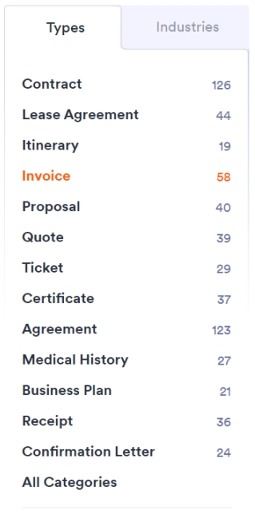
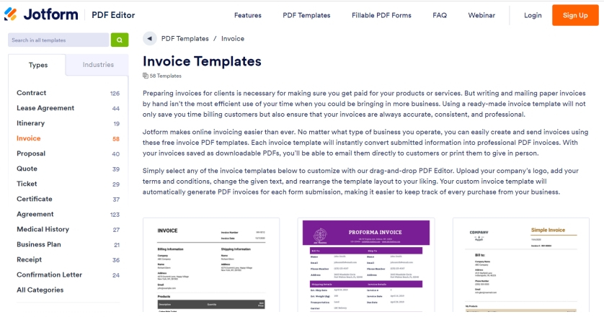
PROBLEM
DESIGN A WEBSITE INTERFACE, THAT LOOK LIKE THIS.
SIDEBAR HAS FOLDER AND SUB-FOLDER.
FOLDER
SUB-FOLDER

Slide 3
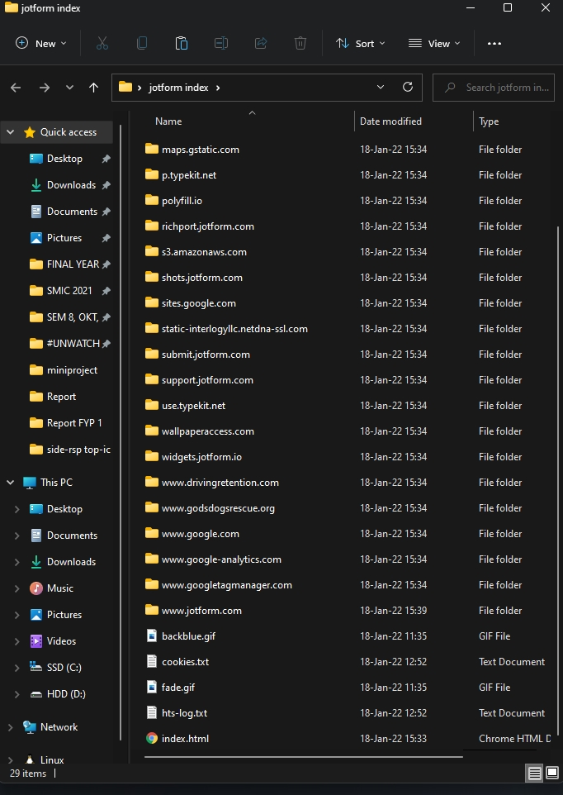
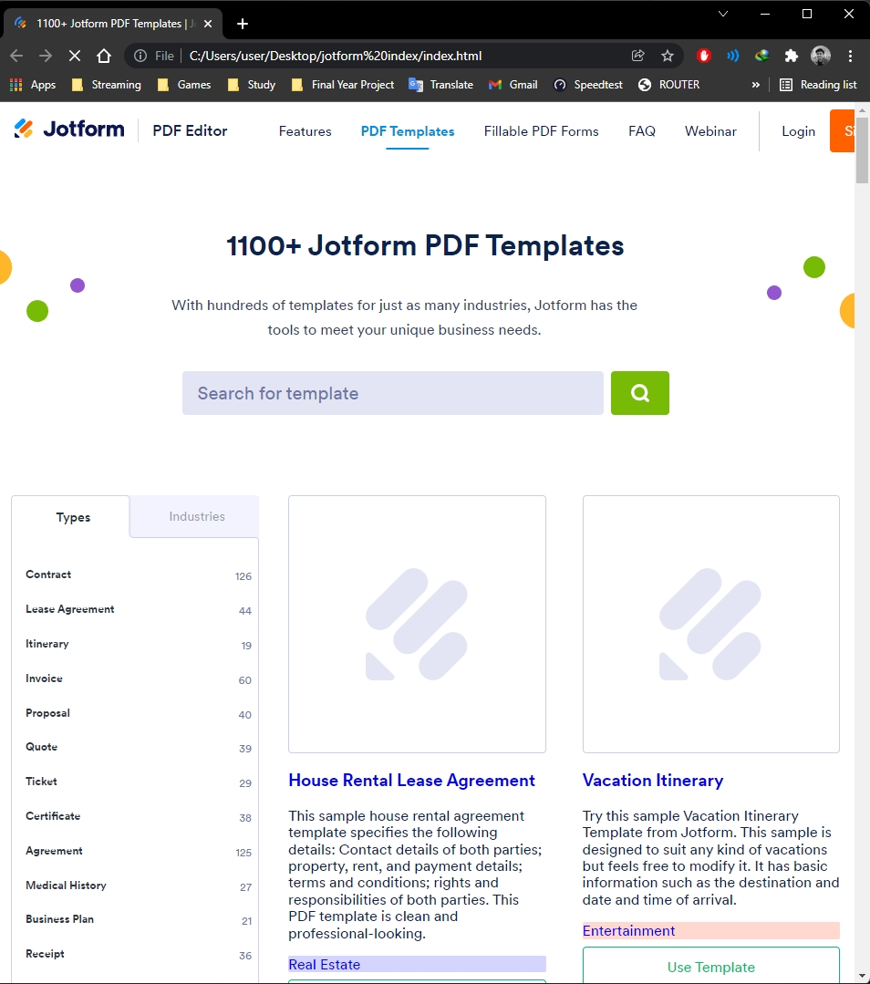

First, we try to use HTTrack to copy the website and get the html file and other file.

Slide 4
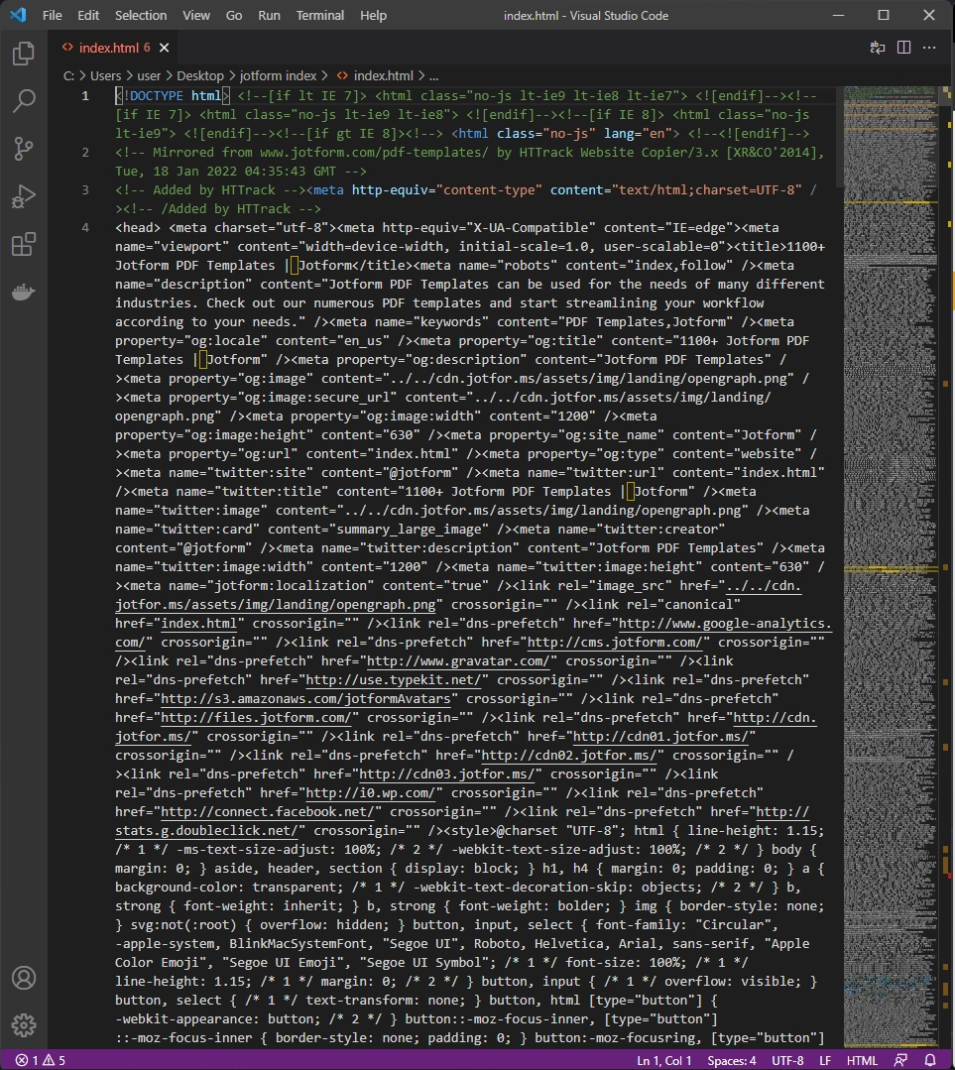
DUPLICATE USING
HTTRACK DUPLICATE WEBSITE
CODING .HTML
But, this is what we get from the html file. That’s why we try to find another way to do it.

Slide 5
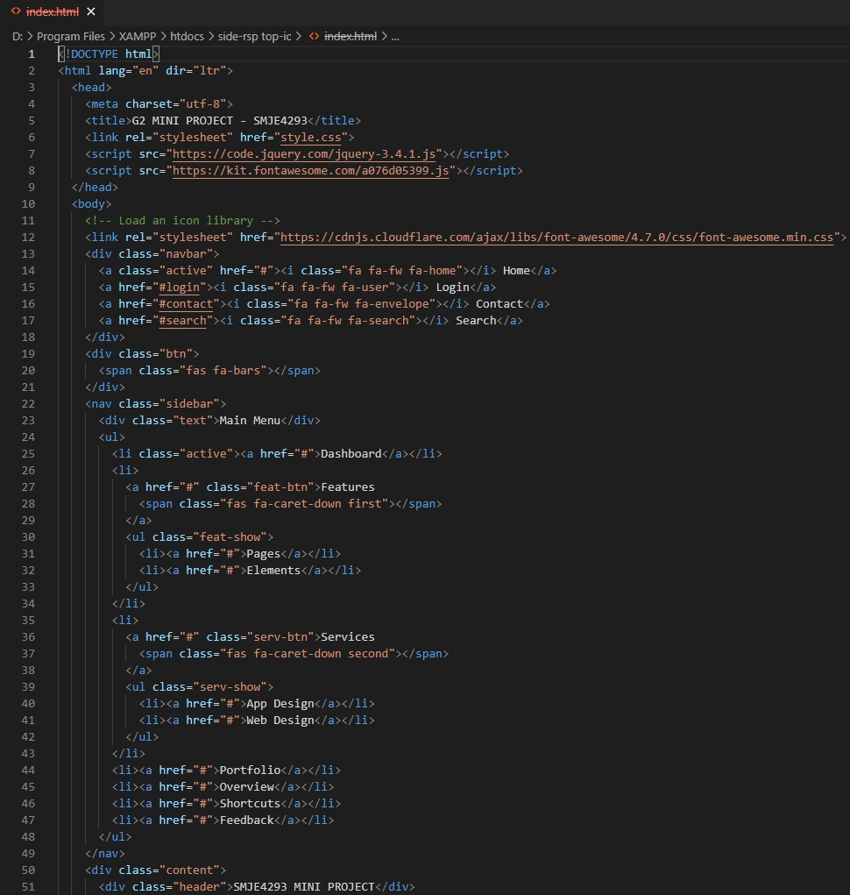
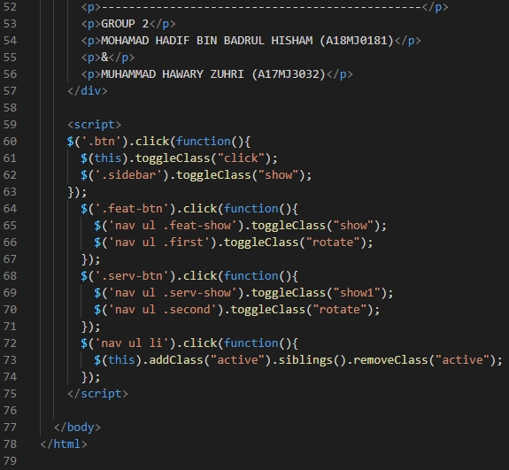
1. FIRST .HTML CODING
VIA VISUAL STUDIO CODE
So, we try to combine multiple html basis coding, and also edit and adjust some part of the coding so it’s going to be what we want.

Slide 6
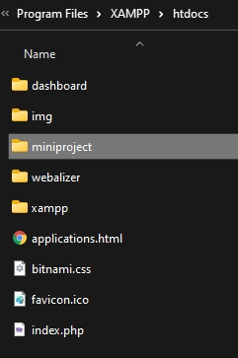
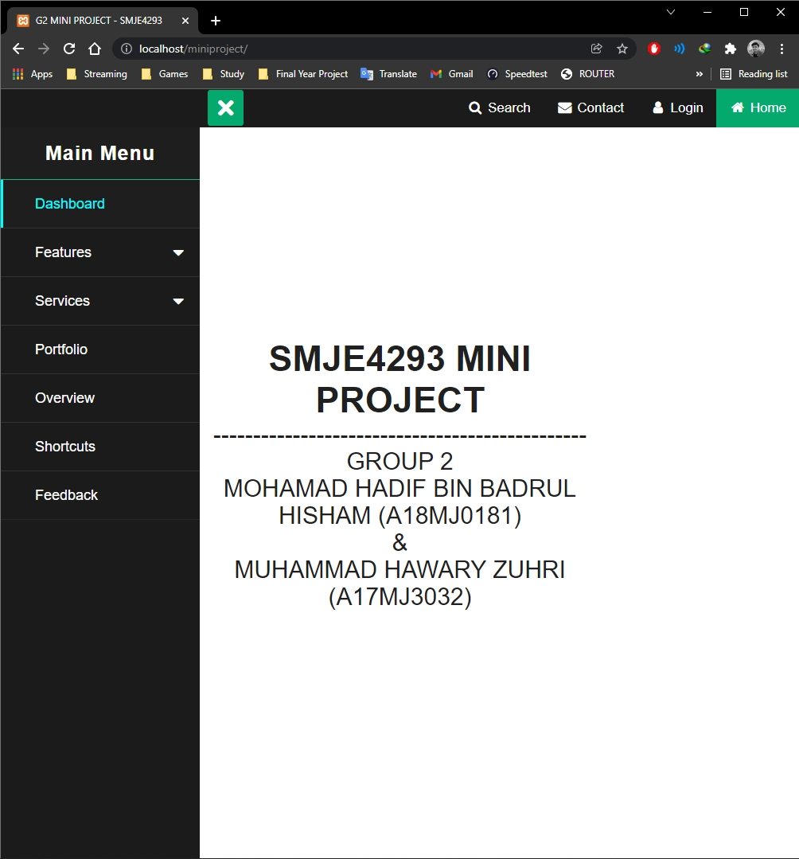

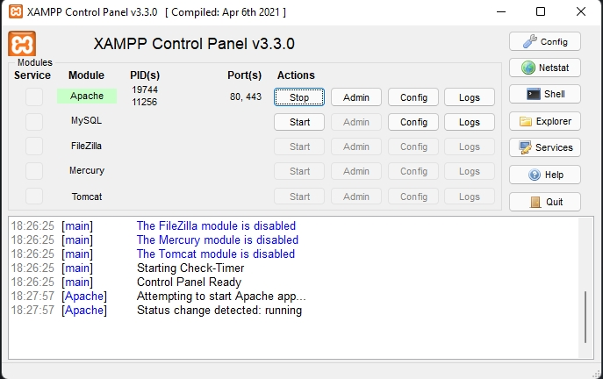
1.1. OPEN VIA XAMPP
Since we want to open in local host, first attempt we use XAMPP to open it in local host.

Slide 7
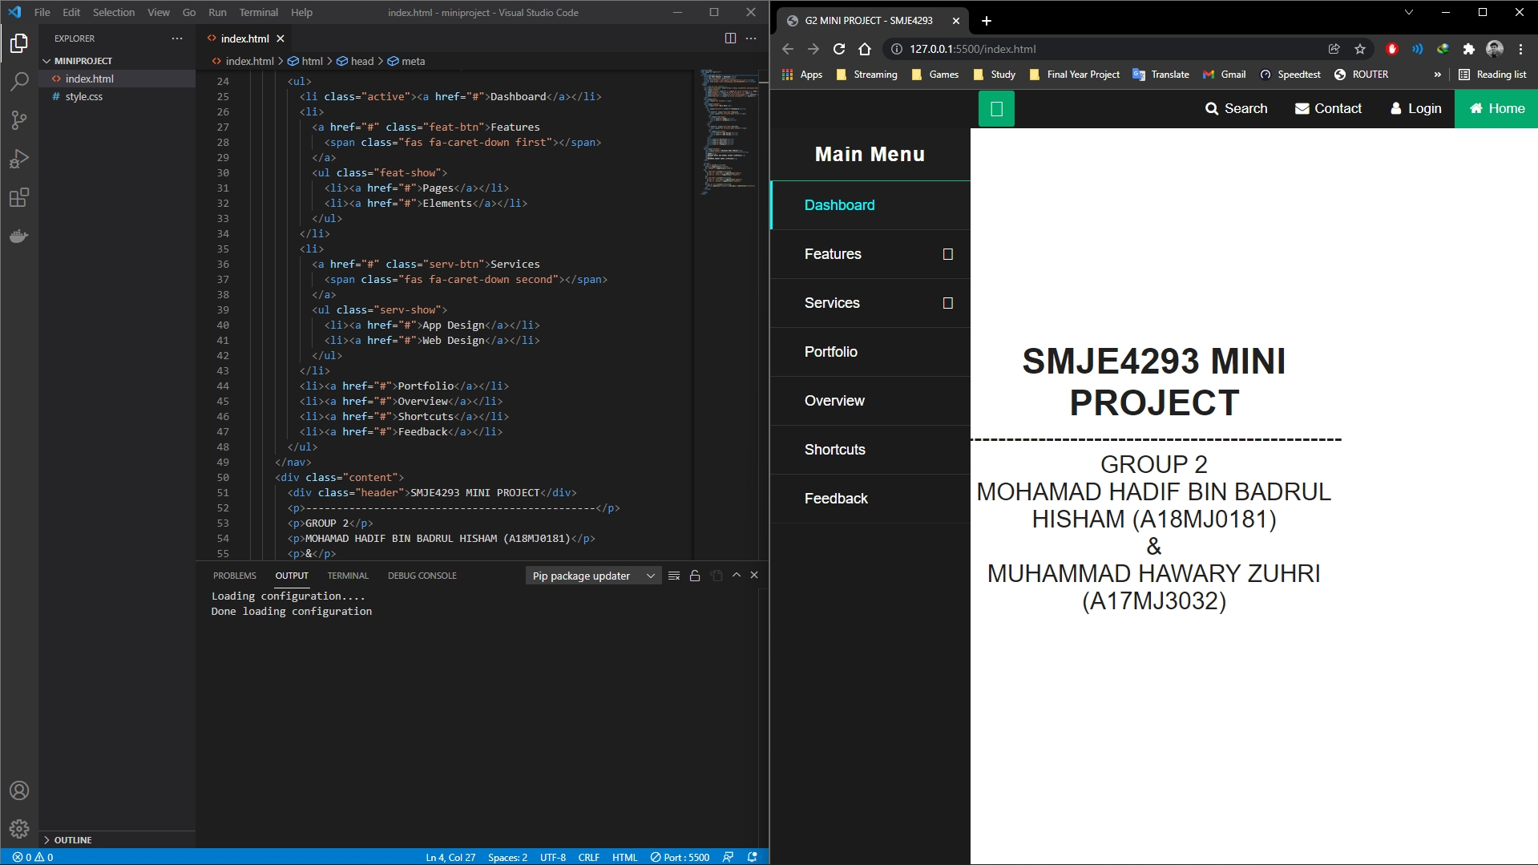

Second try we use LIVESERVER EXTENSION in VISUAL STUDIO CODE to open in in local host.
1.2. OPEN VIA LIVESERVER EXTENSION
IN VISUAL STUDIO CODE

Slide 8
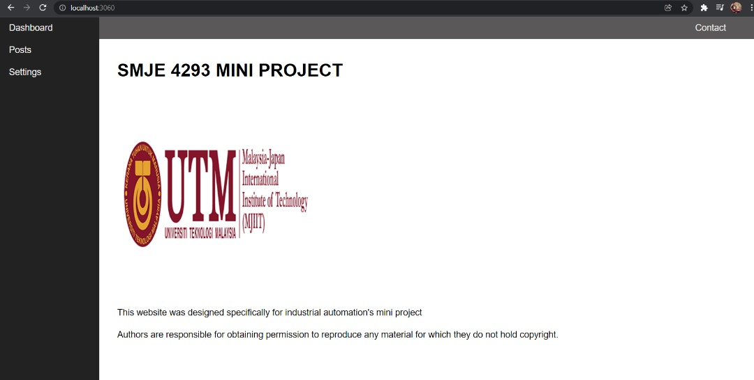
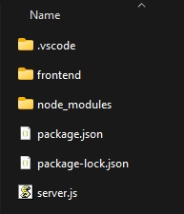
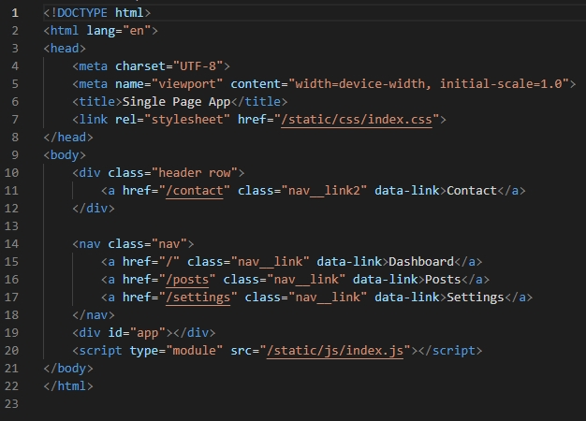

2. SECOND .HTML CODING
OPEN VIA NODEJS
This one is another coding that we made, but we’re not submit it. This one is front end opened in localhost via NODE.JS

